Slide 1
Indian Restaurant Recommendation
Data science
IBM CAPSTONE Project

Slide 2


Problem Description
Migrating from one place to another and wants the restaurant that should be of his choice and its nearby to the address where he is residing. SO the question arises:
Check all the restaurants
Filter the category of your choice
Check the rating and near by location

Slide 3

Target Audience
I believe this is for every person who is shifting from one place to another. As the need for a job everyone must travel and wants to be in a place where he got all the amenities. After a long hour of job, he needs that the daily needs should be nearer as much it can be. So, predicting the Battle of neighborhood is correct for description for this project.

Slide 4
Dataset
1) Using Canada Dataset: https://en.wikipedia.org/wiki/List_of_postal_codes_of_Canada:_M and get latitude, longitude from https://cocl.us/Geospatial_data’
Finding based on address the near by restaurants using Foursquare API. By using this API we will get all the venues in each neighborhood. We can filter these venues to get restaurants based on input we have provided.

Slide 5
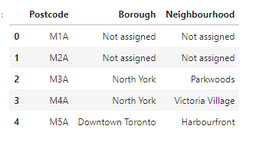
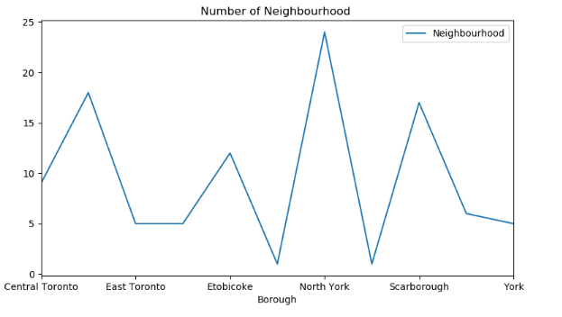
Analysis from the dataset

Slide 6
Using Four Square API
Using Foursquare API, we input the address where we are residing or from where to we search the restaurant.
Using API, we get the latitude and longitude of the given location
Now, input the type of restaurant you want to search.
You will get all the restaurants in radius of 500.
We get the rating of those restaurants and sort them.
Recommend the restaurant which is having the highest rating.

Slide 7
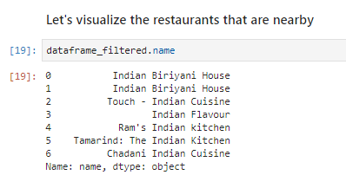
Using Four Square API
These are the filtered restaurants on the basis of search criteria

Slide 8
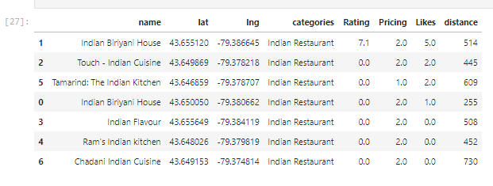
Using Four Square API
Restaurants are sorted on the basis of rating. Like the highest is having the Indian Biryani House.

Slide 9
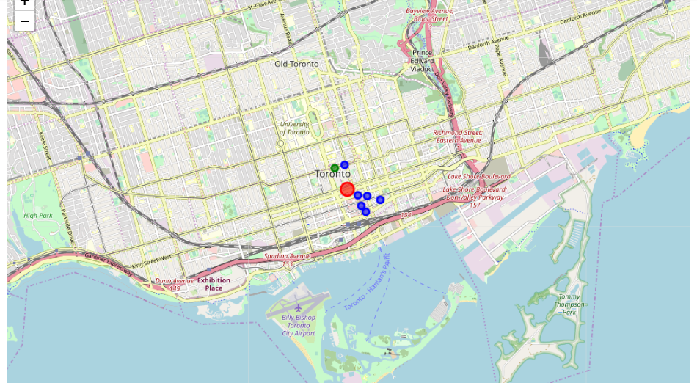
Visualization through Map

Slide 10
Conclusion
The Green Dot on the map shows the Restaurant having the highest rating and also recommended. And the blue dots are the other restaurants that are having less rating from the recommended one.

